Slide 1
Cloud Technology Fundaments 21UCA501

Slide 2
Service Models
l Infrastructure as a Service: IaaS provides virtual machines, virtual storage, virtual infrastructure, and other hardware assets as resources that clients can provision.
The IaaS service provider manages all the infrastructure, while the client is responsible for all other aspects of the deployment. This can include the operating system, applications, and user interactions with the system.
l Platform as a Service: PaaS provides virtual machines, operating systems, applications, services, development frameworks, transactions, and control structures. The client can deploy its applications on the cloud infrastructure or use applications that were programmed using languages and tools that are supported by the PaaS service provider.

Slide 3
Service Models
The service provider manages the cloud infrastructure, the operating systems, and
the enabling software. The client is responsible for installing and managing the application that it is deploying.
l Software as a Service: SaaS is a complete operating environment with applications, management, and the user interface.
In the SaaS model, the application is provided to the client through a thin client interface (a browser, usually), and the customer’s responsibility begins and ends with entering and managing its data and user interaction. Everything from the application down to the infrastructure is the vendor’s responsibility.

Slide 4
Service Models
The three different service models taken together have come to be known as the SPI model of cloud computing. Many other service models have been mentioned: StaaS, Storage as a Service; IdaaS, Identity as a Service; CmaaS, Compliance as a Service; and so forth. However, the SPI services encompass all the other possibilities. It is useful to think of cloud computing’s service models in terms of a hardware/software stack. One such representation called the Cloud Reference Model is shown in Figure 1.5. At the bottom of the stack is the hardware or infrastructure that comprises the network. As you move upward in the stack, each service model inherits the capabilities of the service model beneath it. IaaS has the least levels of integrated functionality and the lowest levels of integration, and SaaS has the most. Examples of IaaS service providers include:

Slide 5
Service Models
C l Amazon Elastic Compute Cloud (EC2)
l Eucalyptus
l GoGrid
l FlexiScale
l Linode
l RackSpace Cloud
l Terremark
All these vendors offer direct access to hardware resources. On Amazon EC2, considered the classic IaaS example, a client would provision a computer in the form of a virtual machine image, provision storage, and then go on to install the operating system and applications onto that virtual system. Amazon has a number of operating systems and some enterprise applications that they offer on a rental basis to customers in the form of a number of canned images, but customers are
free to install whatever software they want to run.

Slide 6
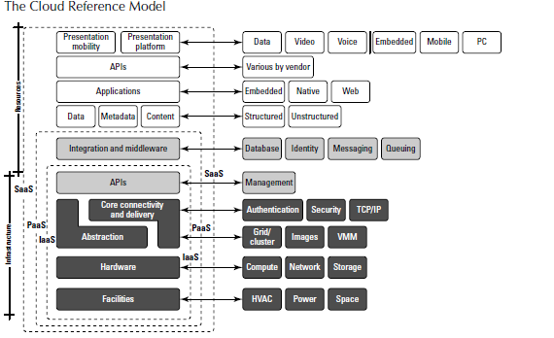
Service Models
Amazon’s responsibilities as expressed in its Service Level Agreement, which is published on Amazon’s Web site, contractually obligates Amazon to provide a level of performance commensurate with the type of resource chosen, as well as a certain level of reliability as measured by the system’s uptime.

Slide 7
THANK YOU

